Slide 1
Gesture Controlled Virtual Mouse
B.Sai Keerthi (21761A5473)
M.Gayathri (21761A54A1)
T.Jaya Dharani (21761A54C5)
K.Geetha Ramya (21761A5495)

Slide 2
What is Virtual Mouse Control?
Controlling the computer mouse using hand gestures detected via a webcam.

Slide 3
Work Flow
Video Capture
Hand Detection
Gesture Recognition
Mouse Control

Slide 4
Tools and Libraries Used
OpenCV(cv2)
MediaPipe(mediapipe)
PyAutoGUI(pyautogui)
Random Module(random)
Pynput(pynput.mouse)

Slide 5
Breaking Down the Methods
Modules Imported: OpenCV, MediaPipe, PyAutoGUI, Math, Pynput.
Main Components:
Gesture Detection
Helper Functions (get_distance, get_angle)
Mouse Control Logic

Slide 6
How Gestures Are Recognized?
Landmarks Tracked: 21 hand points tracked by MediaPipe.
Thumb Tip (4)
Index Tip (8)
Middle Tip (12)
Distance Calculation: Thumb to Index for clicks.
Angle Calculation: Index finger bending for double-click.
Visual: Include a MediaPipe hand landmark diagram.

Slide 7
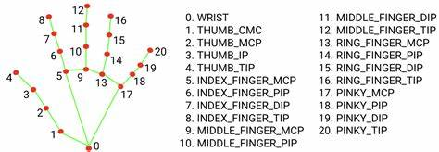
Media Pipe

Slide 8
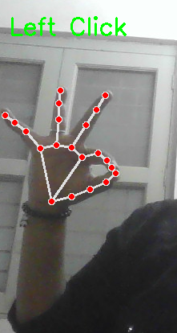
Gesture Detection for Left Click
Thumb (Landmark 4) and Index Finger (Landmark 8) are close together.

Slide 9
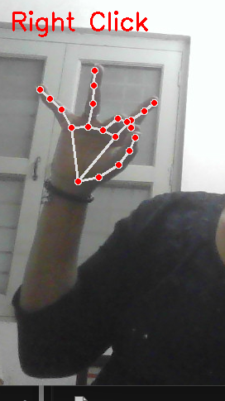
Right Click
Thumb (Landmark 4) and Middle Finger (Landmark 12) are close together.

Slide 10
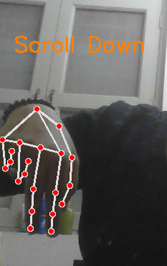
Scroll Down
Middle Finger (Landmark 12) moves down.

Slide 11
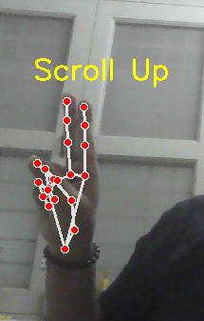
Scroll Up
Middle Finger (Landmark 12) moves up

Slide 12
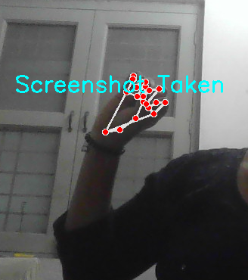
Screenshot
Thumb (Landmark 4) and Little Finger (Landmark 20) are close together .

Slide 13
How It All Comes Together
Contents:
Video Capture (cv2.VideoCapture).
Processing Frames with MediaPipe (hands.process).
Calling Gesture Detection Function.
Real-Time Feedback Display (cv2.imshow).

Slide 14
Where Can It Be Used?
Touchless control for presentations.
Gaming and virtual reality interfaces.
Smart home control systems.

Slide 15
What Were the Challenges?
Lighting conditions affecting detection accuracy.
Limited range of gestures.
High CPU usage in real-time processing.

Slide 16
How Can It Be Improved?
Support for multiple hands.
Customizable gestures for more actions.
Integration with AR/VR systems.

Slide 17
Thank You

